Slide 1
LUC 4
the Feasibility Study

Slide 2
Lecture 4: the Feasibility Study
What is a feasibility study?
What to study and conclude?
Types of feasibility
Technical
Economic
Schedule
Operational
Quantifying benefits and costs
Payback analysis
Net Present Value Analysis
Return on Investment Analysis
Comparing alternatives

Slide 3
Why a feasibility study?
Objectives:
To find out if an system development project can be done:
...is it possible?
...is it justified?
To suggest possible alternative solutions.
To provide management with enough information to know:
Whether the project can be done
Whether the final product will benefit its intended users
What the alternatives are (so that a selection can be made in subsequent phases)
Whether there is a preferred alternative

Slide 4
A management-oriented activity:
After a feasibility study, management makes a “go/no-go” decision.
Need to examine the problem in the context of broader business strategy

Slide 5
Content of a feasibility study
Things to be studied in the feasibility study:
The present organizational system
Stakeholders, users, policies, functions, objectives,...
Problems with the present system
inconsistencies, inadequacies in functionality, performance,…
Goals and other requirements for the new system
Which problem(s) need to be solved?
What would the stakeholders like to achieve?
Constraints
including nonfunctional requirements on the system (preliminary pass)

Slide 6
Possible alternatives
“Sticking with the current system” is always an alternative
Different business processes for solving the problems
Different levels/types of computerization for the solutions
Advantages and disadvantages of the alternatives
Things to conclude:
Feasibility of the project
The preferred alternative.

Slide 7
Exploring Feasibility
The “PIECES” framework
Useful for identifying operational problems to be solved, and their urgency
Performance “ Is current throughput and response time adequate/ enough ?
Information: Do end users and managers get timely, pertinent lrelational , accurate and usefully formatted information?
Economy
Are services provided by the current system cost-effective?
Could there be a reduction in costs and/or an increase in benefits?
Control : Are there effective controls to protect against cheat and to guarantee information accuracy and security?
Efficiency : Does current system make good use of resources: people, time, flow of forms,…?
Services : Are current services reliable? Are they flexible and expandable?

Slide 8
the PIECES frame works
Economics :
unknown costs
untracables cost
too high cost
Brofits
exploring new market
devolpe currents markits

Slide 9
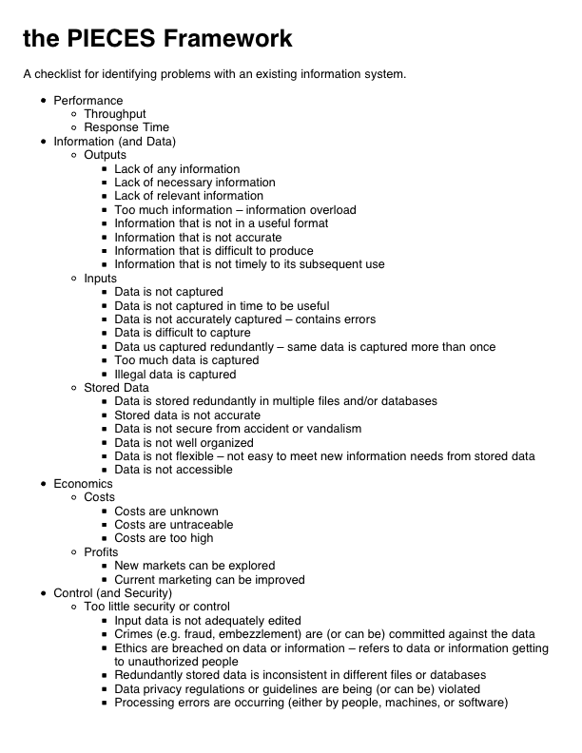
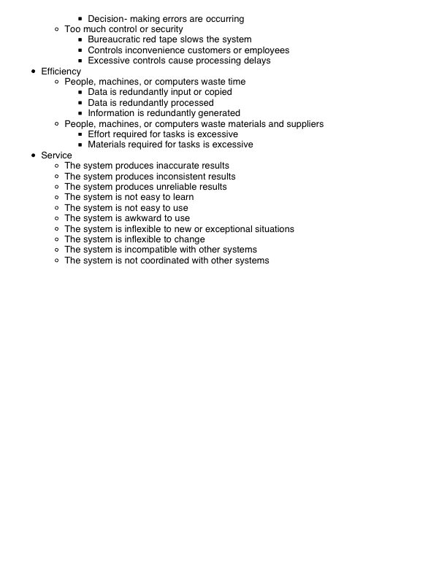

Slide 10
Four Types of feasibility
Technical feasibility
Is the project possible with current technology?
Economic feasibility
Is the project possible, given resource constraints?
Schedule feasibility
Is it possible to build a solution in time to be useful?
Operational feasibility
If the system is developed, will it be used?

Slide 11
Technical feasibility
Is the project possible with current technology?
What technical risk is there?
Availability of the technology:
Is it available locally?
Can it be obtained?
Will it be compatible with other systems?
Economic feasibility
Is the project possible, given resource constraints?
What are the benefits?
Both tangible and intangible
Quantify them!
What are the development and operational costs?
Are the benefits worth the costs?
Schedule feasibility
Is it possible to build a solution in time to be useful?
What are the consequences of delay?
Any constraints on the schedule?
Can these constraints be met?
Operational feasibility
If the system is developed, will it be used?
Human and social issues…
Potential labour objections?
Manager resistance?
Organizational conflicts and policies?
Social acceptability?
legal aspects and government regulations?

Slide 12
Technical Feasibility
Is the proposed technology or solution practical?
Do we currently possess the necessary technology?
Do we possess the necessary technical expertis
Is relevant technology mature enough to be easily applied to our problem?
What kinds of technology will we need?
Some organizations like to use state-of-the-art technology
A mature technology has a larger customer base for obtaining advice concerning problems and improvements.
Is the required technology available “in house”?
If the technology is available:
…does it have the capacity to handle the solution?
If the technology is not available:
…can it be acquired?

Slide 13
Economic Feasibility
Can the bottom line be quantified yet?
Very early in the project…
a judgement of whether solving the problem is worth while.
Once specific requirements and solutions have been identified…
…the costs and benefits of each alternative can be calculated
Cost-benefit analysis
Purpose - answer questions such as:
Is the project justified (I.e. will benefits outweigh costs)?
What is the minimal cost to attain a certain system?
How soon will the benefits accrue?
Which alternative offers the best return on investment?

Slide 14
Examples of things to consider:
Hardware/software selection
Selection among alternative financing arrangements (rent/lease/purchase)
Difficulties
benefits and costs can both be intangible, hidden and/or hard to estimate
ranking multi-criteria alternatives

Slide 15
Benefits Costs
Tangible Benefits
Readily quantified as $ values
Examples:
increased sales
cost/error reductions
increased throughput/efficiency
increased margin on sales
more effective use of staff time
Intangible benefits
Difficult to quantify
But maybe more important!
business analysts help estimate $ values
Examples:
increased flexibility of operation
higher quality products/services
better customer relations
improved staff morale
How will the benefits accrue?
When - over what timescale?
Where in the organization?
Development costs (OTO)
Development and purchasing costs:
Cost of development team
Consultant fees
software used (buy or build)?
hardware (what to buy, buy/lease)?
facilities (site, communications, power,...)
Installation and conversion costs:
installing the system,
training personnel,
file conversion,....
Operational costs (on-going)
System Maintenance:
hardware (repairs, lease, supplies,...),
software (licenses and contracts),
facilities
Personnel:
For operation (data entry, backups,…)
For support (user support, hardware and software maintenance, supplies,…)
On-going training costs

Slide 16
Example: costs for small Client-Server project

Slide 17
Analyzing Costs vs. Benefits
Identify costs and benefits
Tangible and intangible, one-time and recurring
Assign values to costs and benefits
Determine Cash Flow
Project the costs and benefits over time, e.g. 3-5 years
Calculate Net Present Value for all future costs/benefits
determines future costs/benefits of the project in terms of today's dollar values
A dollar earned today is worth more than a potential dollar earned next year

Slide 18
Do cost/benefit analysis
Calculate Return on Investment:
Allows comparison of lifetime profitability of alternative solutions.
ROI = Total Profit = Lifetime benefits - Lifetime costs
Total Cost Lifetime costs
Calculate Break-Even point:
how long will it take (in years) to pay back the accrued costs:
@T (Accrued Benefit > Accrued Cost)

Slide 19
Calculating Present Value
A dollar today is worth more than a dollar tomorrow…
Your analysis should be normalized to “current year” dollar values.
The discount rate
measures opportunity cost:
Money invested in this project means money not available for other things
Benefits expected in future years are more prone to risk
This number is company- and industry-specific.
“what is the average annual return for investments in this industry?”
Present Value:
The “current year” dollar value for costs/benefits n years into the future
… for a given discount rate i
1
Present_Value(n) = (1 + i)^{n}
E.g. if the discount rate is 12%, then
Present_Value(1) = 1/(1 + 0.12)¹ = 0.893
Present_Value(2) = 1/(1 + 0.12)² = 0.797

Slide 20
Net Present Value
Measures the total value of the investment
…with all figures adjusted to present dollar values
NPV = Cumulative PV of all benefits - Cumulative PV of all cost
Assuming subsequent years are like year 4…
the net present value of this investment in the project will be:
after 5 years, $13,652
after 6 years, $36,168

Slide 21
Return on Investment (ROI) analysis
For comparing overall profitability
Which alternative is the best investment?
ROI measures the ratio of the value of an investment to its cost.
ROI is calculated as follows:
ROI = Estimated lifetime benefits - Estimated lifetime costs Estimated lifetime costs

Slide 22
or:
ROI = Net Present value / Estimated lifetime costs
For our example
ROI = (795,440 - 488,692) / 488,692 ≈ 63%,
or ROI = 306,748 / 488,692 ≈ 63%
Solution with the highest ROI is the best alternative
But need to know payback period too to get the full picture
E.g. A lower ROI with earlier payback may be preferable in some circumstances

